Slide 1
Personalized Treatment Recomentations
TSP- AI ML Fundamentals (Capstone Project)
Presented By:
SRINIVASAN M-au810021102034
Guided By: RAJA P, Master Trainer

Slide 2
OUTLINE
Problem Statement
Proposed System/Solution
Algorithm & Deployment
GitHub Link
Project Demo(photos / videos)
Conclusion
Future Scope
References

Slide 3
Problem Statement
In traditional healthcare, treatments are often generalized, applying the same protocols across diverse patient populations. This "one-size-fits-all" approach can lead to ineffective outcomes, as it fails to account for the complex individual differences among patients, such as genetic makeup, lifestyle, and medical history. Consequently, there is an urgent need for personalized treatment systems that can tailor healthcare solutions to each patient’s unique profile, leading to better outcomes and reducing the burden of ineffective treatments.

Slide 4
Proposed Solution
To address the challenges of personalized treatment in healthcare, the proposed solution is a data-driven, machine-learning-based recommendation system that delivers tailored treatment plans for each patient. This system will integrate multiple sources of patient-specific information, including:
1. Patient Data Collection and Integration
2. Data Processing and Feature Engineer
3.Machine Learning Model for Treatment Prediction
4.Explainable AI and Decision Support
5.Feedback and Outcome Monitoring
6.Data Privacy and Compliance
7.Pilot Testing and Validation.

Slide 5
Algorithm & Deployment
Data Collection and Preprocessing:Collect and preprocess data from various sources like medical records, genetic profiles, patient history, and wearable health data.
Feature Engineering:Identify important features (e.g., age, medical history, lifestyle factors) that may impact treatment decisions.
Supervised Learning Models: Use models such as logistic regression, decision trees, random forests, or gradient boosting for prediction tasks like treatment response or risk assessment.
Cloud Computing Platforms: Use cloud services (like AWS, Google Cloud, or Azure) for scalable storage and computing power.
Data Pipeline Management: Set up ETL (extract, transform, load) pipelines to automatically handle and process data from different sources, updating patient data in real-time.

Slide 6
GitHub Link
https://github.com/Srinivasanmathi/Srinivasan-au810021102034

Slide 7
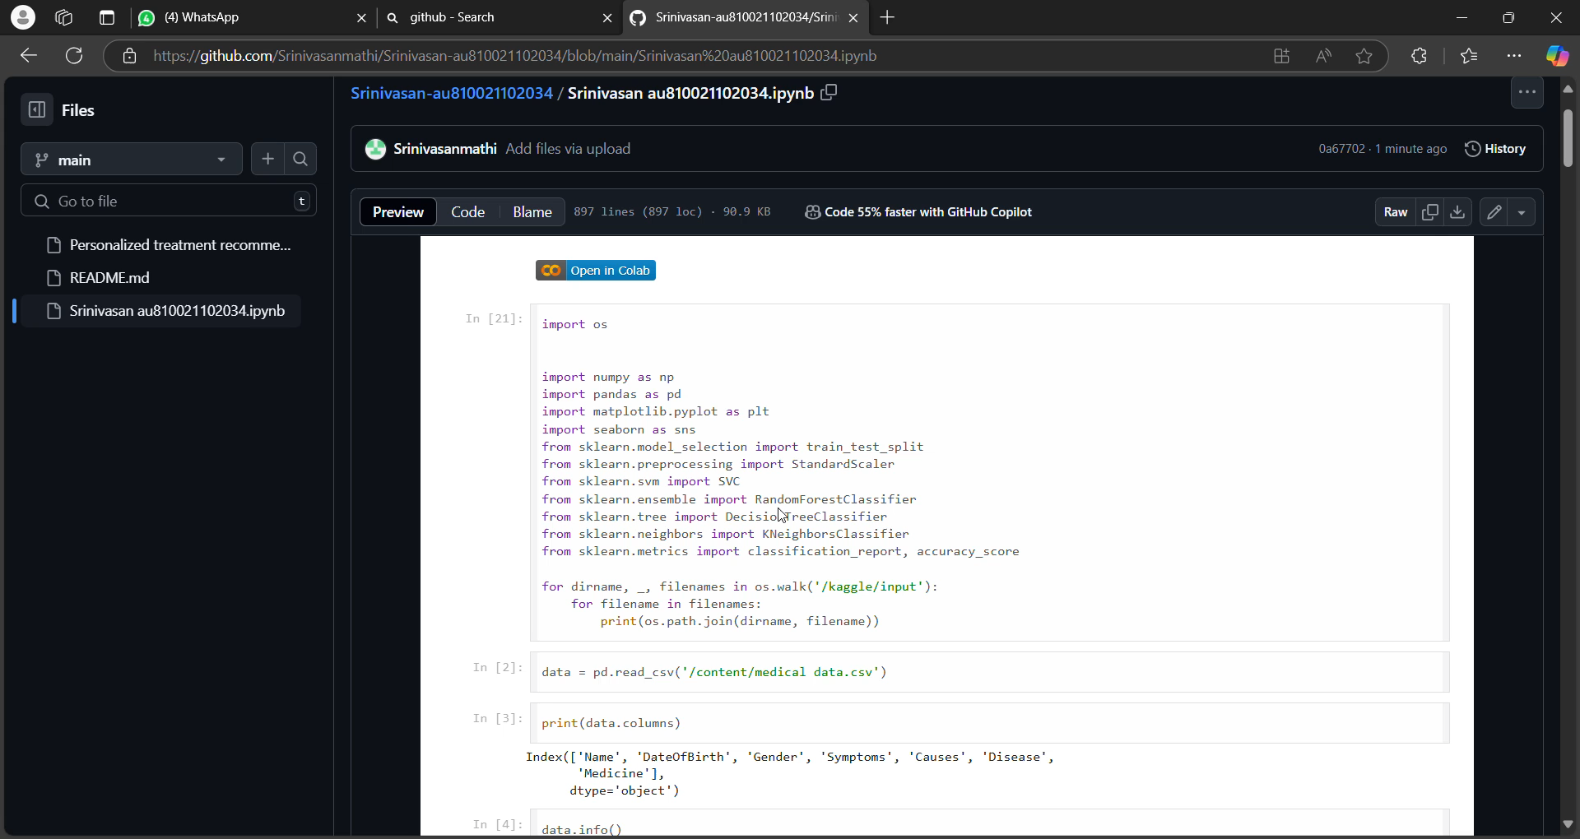
Project Demo(Recorded Video)

Slide 8
Conclusion
The AI-driven personalized treatment recommendation system has the potential to revolutionize healthcare by providing more accurate, individualized care based on a patient’s unique profile. By integrating diverse data sources, employing advanced machine learning techniques, and ensuring transparency with interpretability methods like SHAP and LIME, the system offers a reliable and fair approach to improving patient outcomes. While there are limitations in terms of data quality, bias mitigation, and integration with current healthcare systems, the proposed solutions and future work aim to address these challenges. The successful development and implementation of this system can contribute to a more personalized, efficient, and equitable healthcare system, offering tangible benefits for both patients and clinicians.

Slide 9
Future Scope
1.Data Enhancement: Collecting more comprehensive datasets that include diverse patient populations and ensuring data accuracy and completeness will improve the system's predictive capabilities.
2.Bias Mitigation: Developing more robust methods for detecting and addressing biases in patient data and model outputs to ensure fairness across all demographic groups.
3.Real-time Recommendations: Exploring real-time data collection and analysis for providing continuous, up-to-date treatment suggestions based on changing patient conditions

Slide 10
References
1.Johnson, A. E., et al. (2016). "MIMIC-III, a freely accessible critical care database." Scientific Data, 3, 160035.
2.Ribeiro, M. T., Singh, S., & Guestrin, C. (2016). "Why should I trust you?" Explaining the predictions of any classifier. In Proceedings of the 22nd ACM SIGKDD International Conference on Knowledge Discovery and Data Mining (pp. 1135-1144).
3.Lundberg, S. M., & Lee, S. I. (2017). "A unified approach to interpreting model predictions."
Advances in Neural Information Processing Systems, 30.
URL: https://arxiv.org/abs/1705.07874.

Slide 11
THANK YOU

